Slide 1
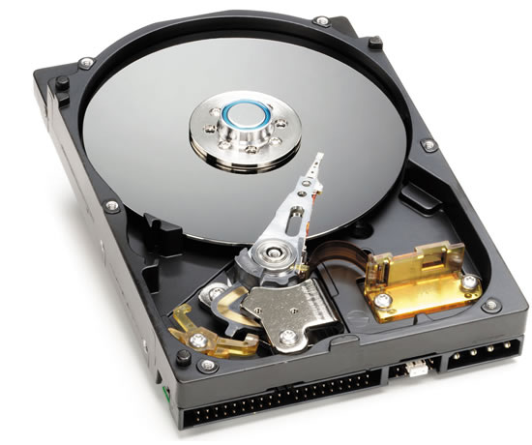
Hard Disk
A hard disk drive (HDD), hard disk, hard drive or fixed disk is a data storage device that uses magnetic storage to store and retrieve digital information using one or more rigid rapidly rotating disks (platters) coated with magnetic material.

Slide 2
Hard disk Partitions:
Master boot record (MBR):
Master Boot Record (MBR) disks use the standard BIOS partition table.
Partitions:
A primary partition is in which an Operating System can be installed. One MBR hard disk may contain a maximum of 4 primary partitions.
Logical partitions, at the same time, there can only be one extended partition on a single disk.
Primary only can be created four maximum, this need to use extended partition to break the limitation of 4 partitions.
In an Extended Partition you can create unlimited logical drives. You can store data in the logical partitions similar with primary partition, but the extended partition is not used to store data, because the Extended Partition is used to hold

Slide 3
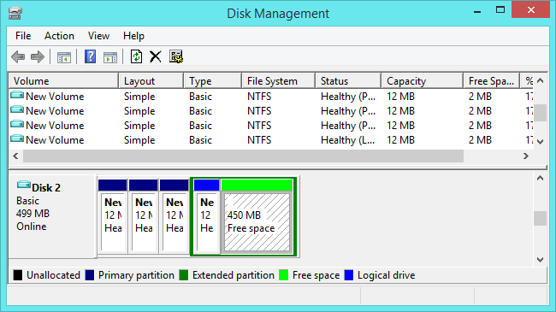

Slide 4
GPT (GUID Partition Table):
GUID partition table (GPT) disks use unified extensible firmware interface (UEFI).
One advantage of GPT disks is that you can have more than four partitions on each disk.
GPT is also required for disks larger than 2 terabytes.
Types of dynamic volumes:
Simple Volumes:
It’s just like the primary or logical partition of basic disk. If there is only one dynamic disk, we can only create simple volume.
A simple volume can be extended within the same disk or onto additional disks.
Spanned volumes:
Consist of at lease two dynamic disks. The areas of unallocated space used to create spanned volumes can be different sizes.
Spanned volumes are organized sequentially and are not fault tolerant. It also can be extended and mirrored.

Slide 5
Striped volumes:
Stripped volumes are composed of free space on two more disks, which is similar to spanned volumes.
However, the difference is that stripped volumes can improve the writing and reading speed of data by adding data to all disks at the same time.
A striped volume cannot be mirrored or extended and is not fault tolerant.
Mirrored volumes:
Mirrored volumes are also known as RAID 1.
A mirrored volume is a fault-tolerant partition that stores an exact copy of data from another disk. Mirrored volumes need two disks; if one disk fails another can be unaffected and work normally.
RAID-5 volumes :
RAID-5 is a combination of striped and mirrored volume.
It is fault tolerant and has a high writing and reading speed of data. RAID-5 volumes are available only on computers running server operating systems.

Slide 6
